Slide 1

MuSa
The experience manager
designed by Silvia Del Piano, Stefano Foti and Gianmarco Zizzo

Slide 2
PRODUCT IDEA

Slide 3
WHAT MUSA IS
MuSa has ben tought as an experience manager for the «Museo dell’Arte Classica della Sapienza». The basic concept of MuSa is to put the user at the center of the experience, satisfying his curiosity and offering him a customized way to visit a museum.
Going into details, we thought about many issues that a visitor have when he visits a museum such as: - limited time for take a full visit - meet on his path some pieces of arts that he does not like for various reasons - the desire of having more details about an opera, but at the same time he does not like to have a guide
MuSa solves these issues in an interactive way! When a visitor comes to the museum and decides to have an experience with MuSa, he is profiled, filling a brief questionnaire on his smartphone, through his interests and some other traits like age or time to spend into the museum; then, MuSa provides to the visitor a customized tour and supports him along the tour, supplying details and
curiosities when he requests it.

Slide 4

HOW MUSA COMES TO LIFE
Through an online questionnaire, we gave life to some personas
Some personas would try an experience with MuSa and moreover they allow the collecting of some data during their tour to help to improve the service…
At the end of the tour, they can also leave a quality feedback
… other personas maybe does not need the company of MuSa, but they want to help the service get better too, so they allow the data collecting

Slide 5
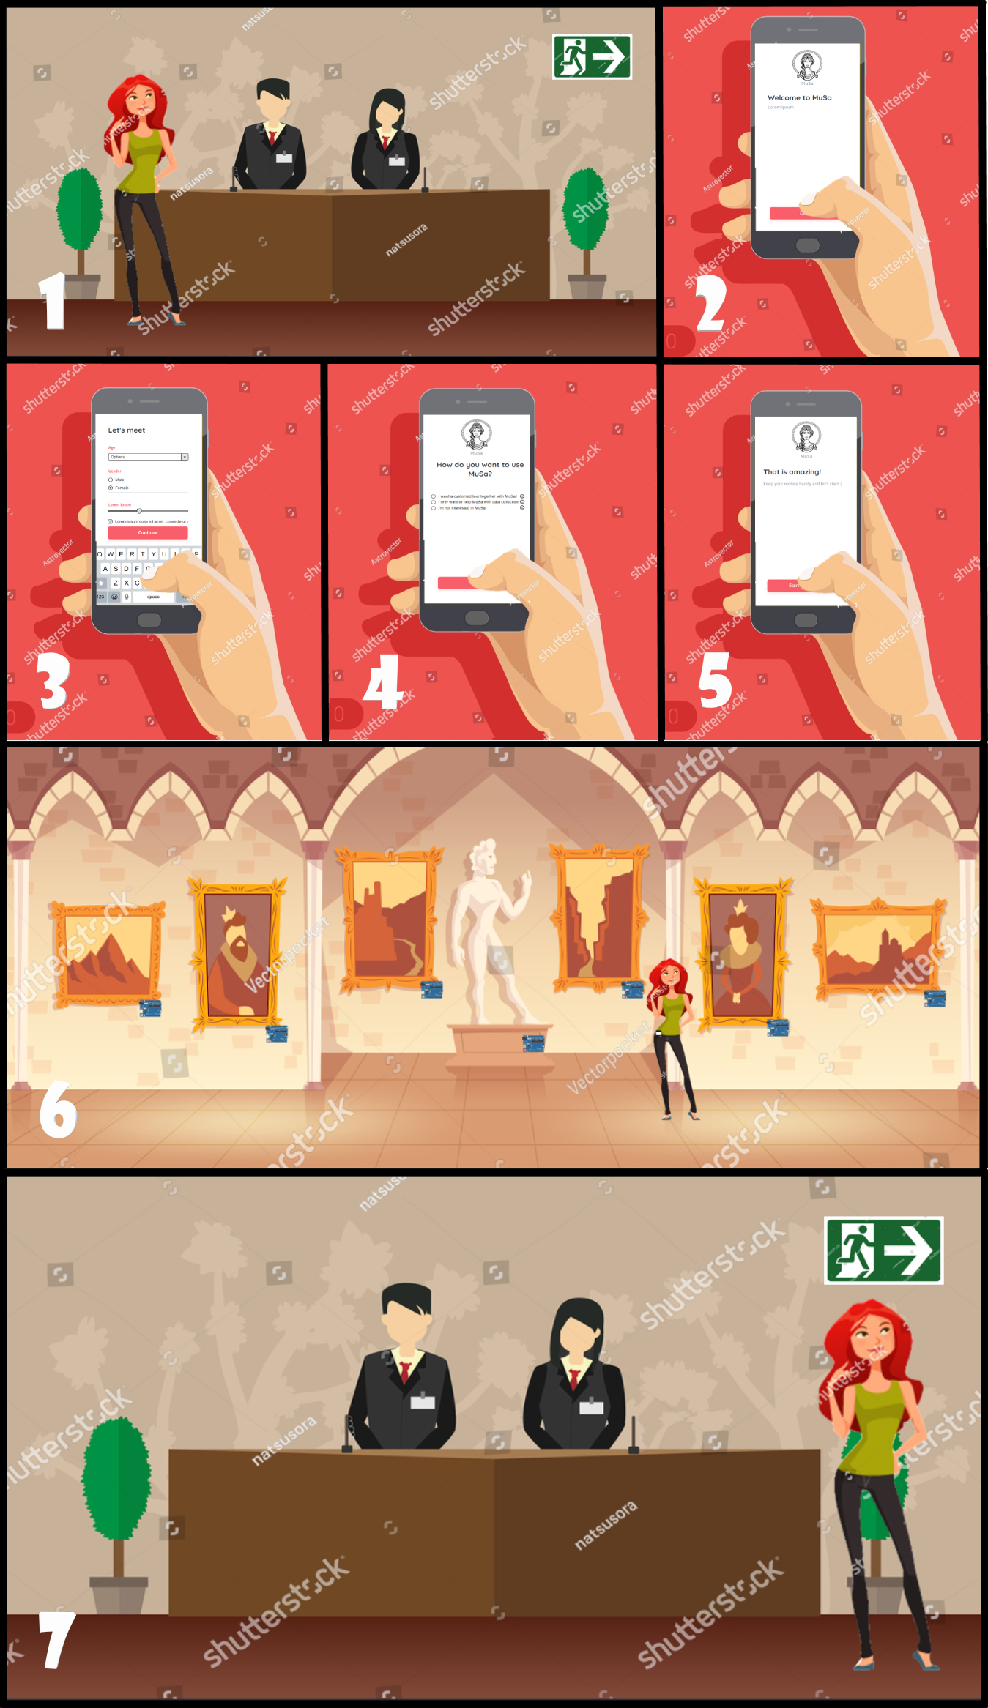
HOW MUSA WORKS
Elena comes to the Museo dell’Arte Classica,
but she does not need MuSa for many reasons.
Anyway, she wants to help the improvement of the service, so she allows the data collecting during her tour, after filling the profiling questionnaire.

Slide 6
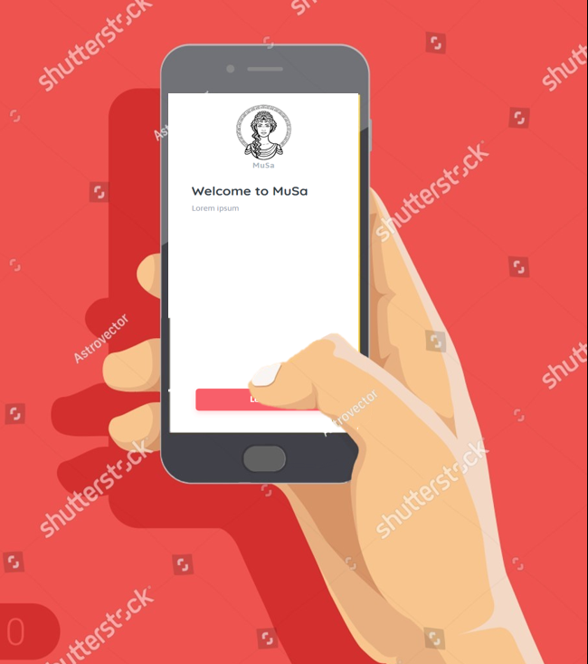
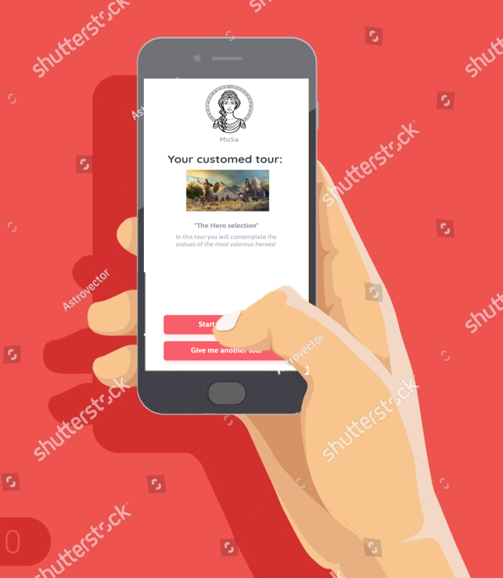
INTERACTION WITH MUSA
In the first idea, all the interactions with MuSa will occur
through the visitor’s smartphone with a web-app:
fill in the questionnaires
get a personalized tour
ask to MuSa for further information and curiosities
data collection

Slide 7
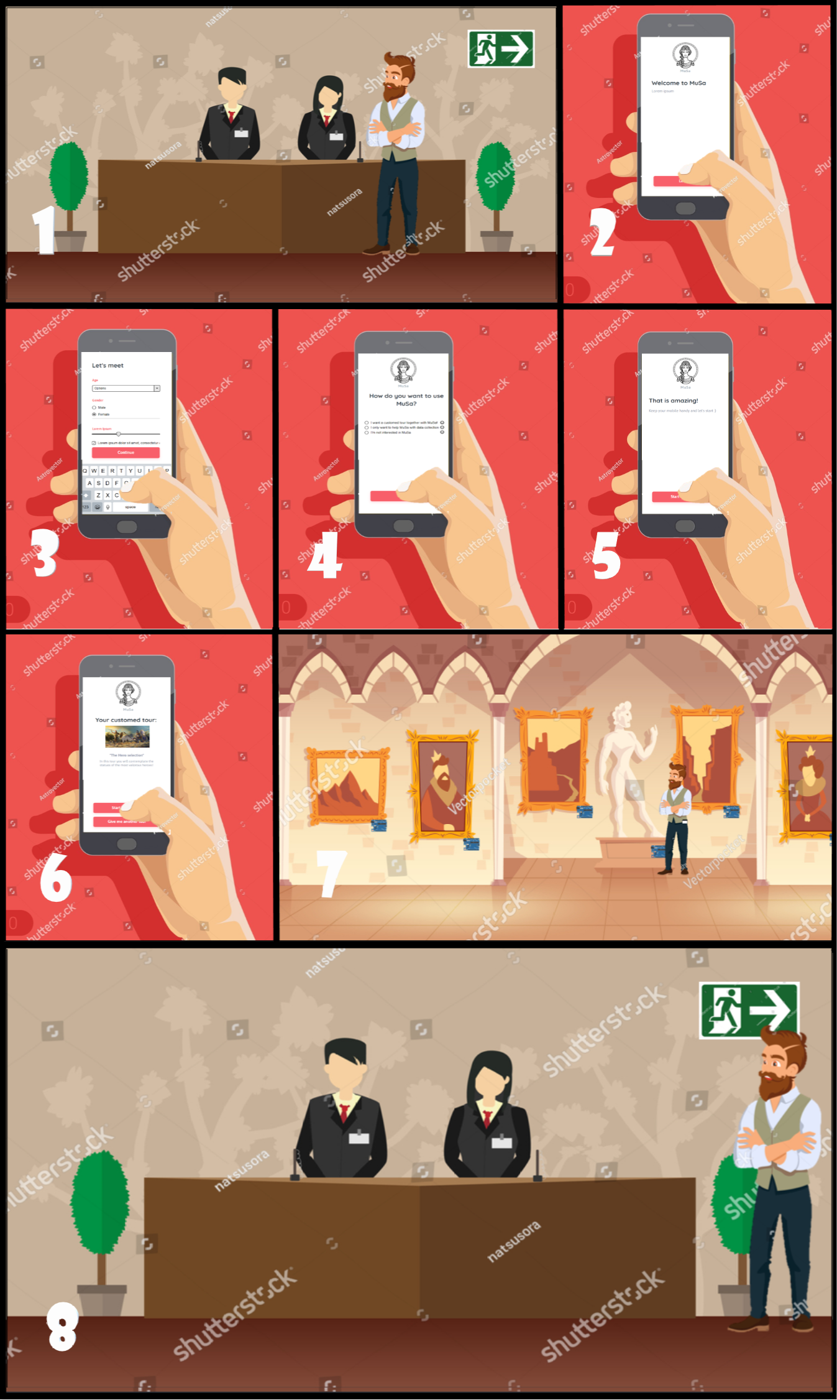
HOW MUSA WORKS
Enea comes to the Museo dell’Arte Classica
and hearing about MuSa decides to have a tour
with her. Firstly, he fills the profiling survey
and MuSa provides him a customized tour, for
example the tour that leads him to visit all the
operas with the topic of war as background.
Enea starts to visit the museum following
MuSa’s suggestions, interacting with her through
his smartphone. He can ask MuSa for extra information or curiosities!
At the end of the tour, Enea will complete
another brief survey to let the museum know is
level of appreciation.

Slide 8

ARCHITECTURE OVERVIEW

Slide 9
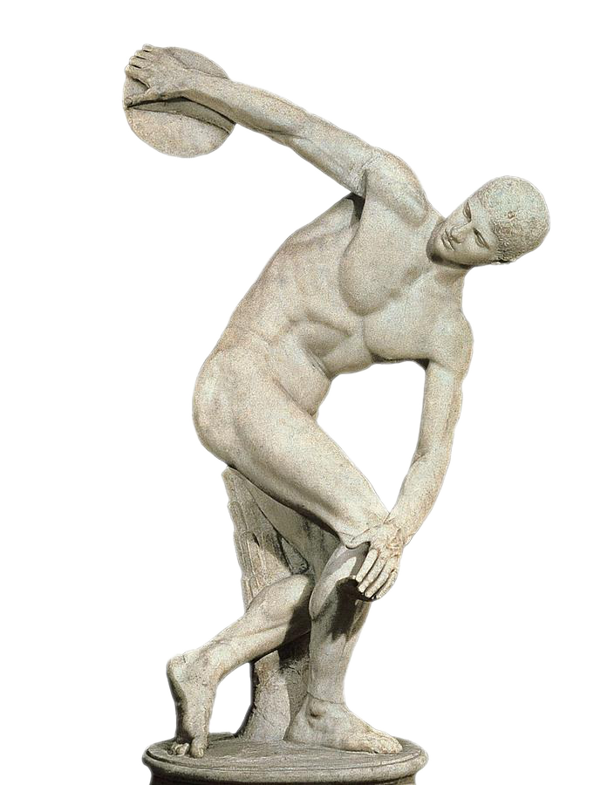
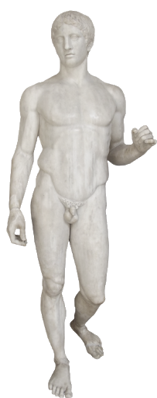

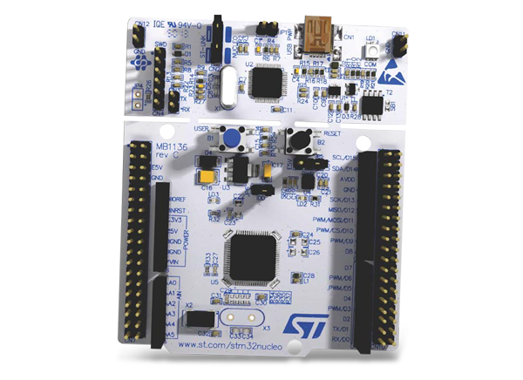


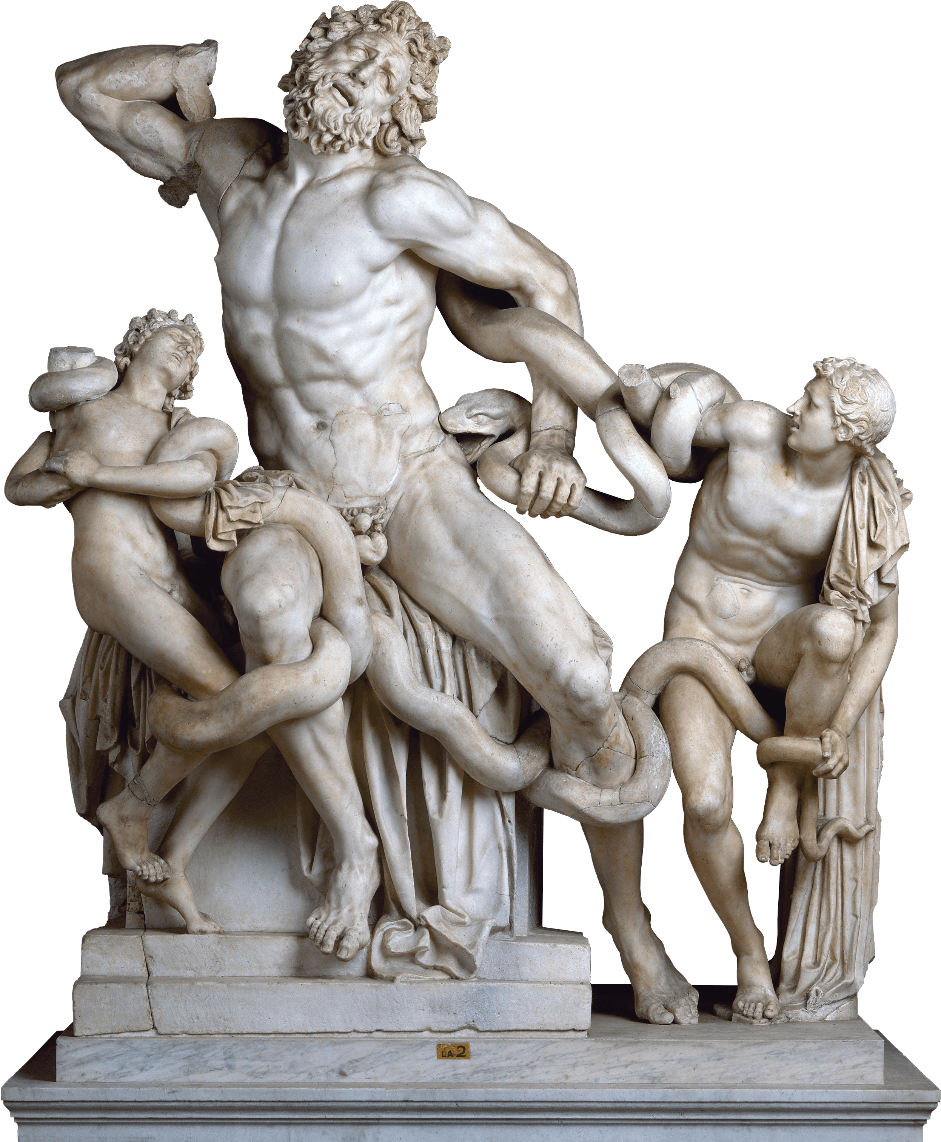
POSITIONING ARCHITECTURE
Server based positioning
The visitor has a tag that advertises their MAC address or UUID. The signal is catched by specific hardware and which is then transmitted to server for calculating and gathering statistics.

Slide 10







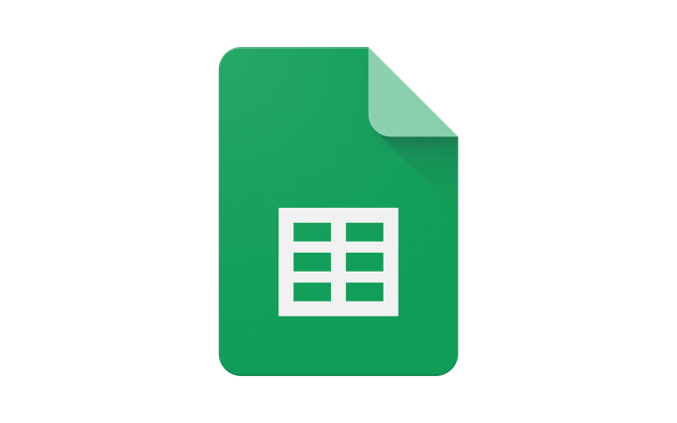

SOFTWARE
HARDWARE
Smartphone
Azure IoT Hub
STM-Nucleo
RIOT-OS
PROTOCOLS
App Service
MQTT
Azure ML
MQTT-SN
Sheets
BLE
Azure DB

Slide 11
Azure IoT Hub
App Service
MQTT-SN
Azure DB
MQTT
MQTT-SN
Azure ML
Sheets

Slide 12
EVALUATION

Slide 13
WHAT IS EVALUATION?
We define EVALUATION as the specification of parameters to establish our software’s quality.
In particular, we focus on:
the user experience (UX)
the technologies involved

Slide 14
User Experience

Slide 15
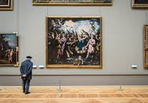
USER EXPERIENCE
OUR USERS ARE IMPORTANT!
The users are the heart of the project: our starting and finishing point!
We want to make sure they’ve had a pleasant experience using our product.

Slide 16
UXEM (USER EXPERIENCE EVALUATION METHODS)
Moment method
Episode method
Thanks to the interaction with MuSa we can understand the visitor's mood
(for example, if he is not following the proposed tour we can assume he probably is not enjoying it).
For this purpose we suggest to use also a commercial tool like PrEmo that allows MuSa to know the user's feeling in real-time.
At the end of the visit the user will be asked to fill a short survey about his experience.
This can be done using also the AttrakDiff tool.

Slide 17
Technology

Slide 18
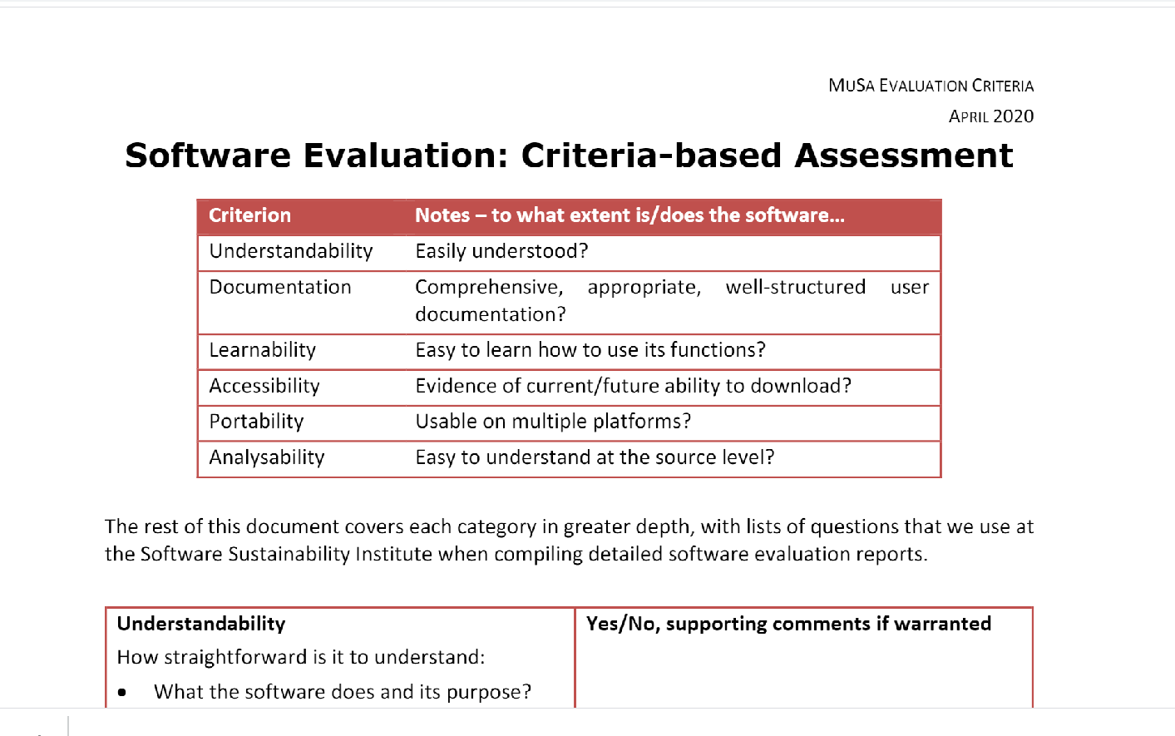
OVERALL EVALUATION
MuSa Criteria
Software quality is defined by a set of regulations and guidelines by ISO/IEC 9126-1. We used a criteria-based evaluation which gives a measurement of quality in a number of areas, including understandability, documentation and portability.
Of course, we did not use the criteria we did not need for, so we produced a lighter customized version.
We also suggest you to run security tests using one of the tools proposed in the evaluation document on the project’s GitHub page.

Slide 19
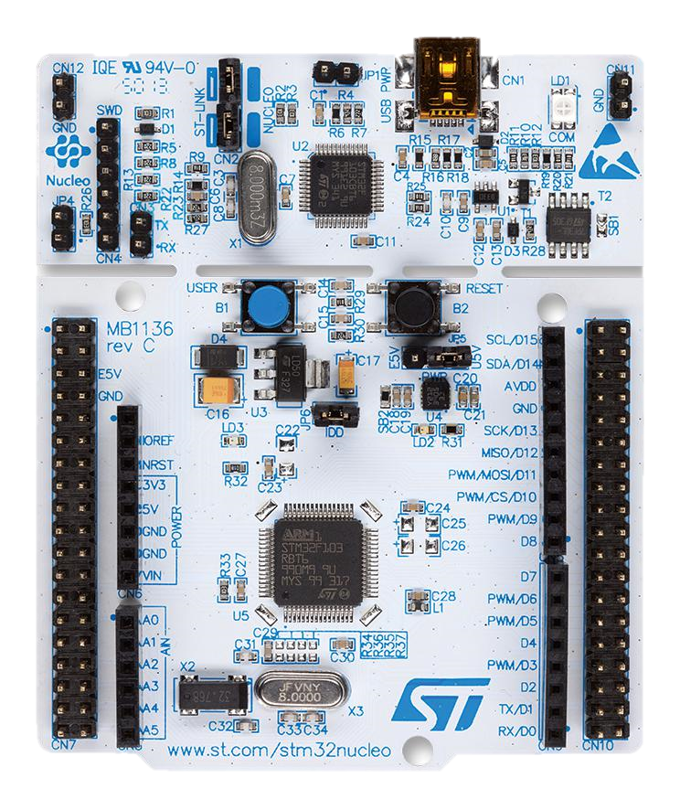
SENSOR NETWORK
Main Aspects to Consider
The board:
STM-Nucleo
Power consumption
- Little energy usage
- Low price (10 – 15 €)
- Widely used
- Rich documentation and examples
Communication complexity
Scalability
All these metrics can be evaluated once the project is deployed.

Slide 20
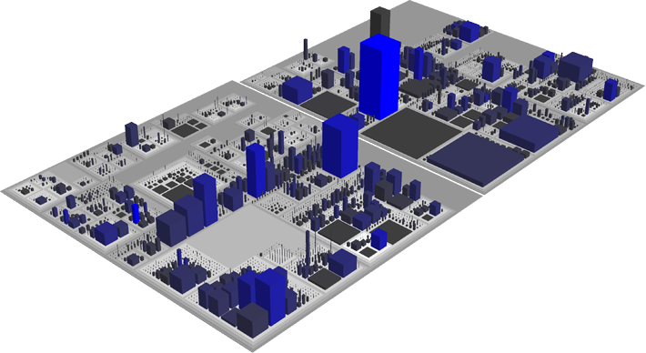
BACKEND
Code City
It is a very simple tool that allows to check the most common software metrics in a new way in which software systems are visualized as interactive, navigable 3D cities.
Classes are represented as buildings in the city,
while the packages are depicted as the districts in which the buildings reside.
The more the city is well structured, the higher the code quality is.

Slide 21
Price

Slide 22
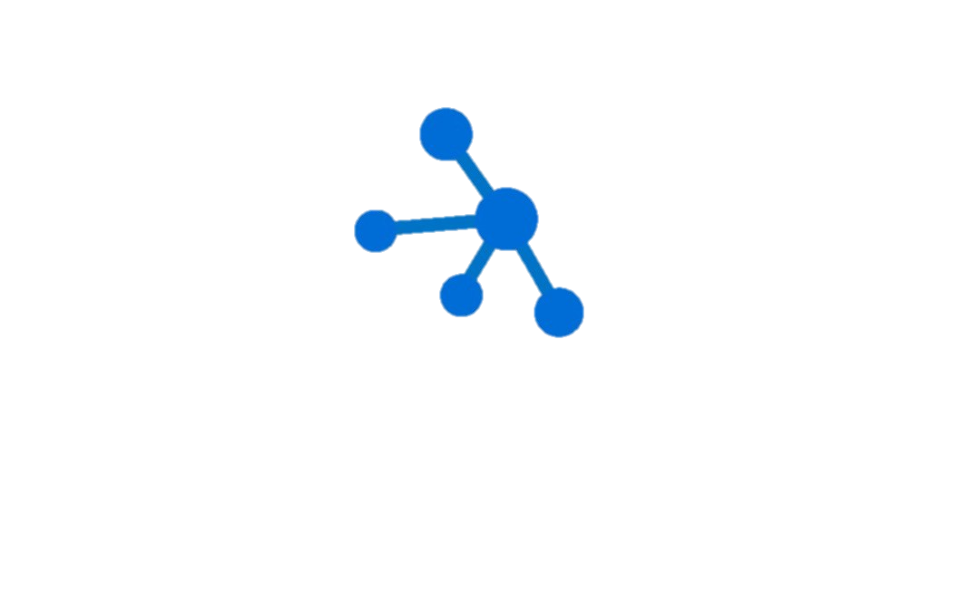
Azure IoT Hub
Azure Database
Azure App Service Plan
PRICE
STM-Nucleo
Azure Machine Learning
Free until
8000 messages/day
Free for
the previous Azure Database generation (the 4th),
few GB of space
Major drawback:
you can not have any backup possibility
Free
complete solution to deploy a full-stack application with both FE and BE.
1GB of storage
1GB of RAM
shared CPU
Please note that in such a way you can not keep your application always running.
Does not offer any free plan It starts at about
4 USD/month.
10 – 15 €
For further details, please have a look at Microsoft Pricing Calculator.

Slide 23
RESOURCES
USEFUL LINKS
MuSa GitHub page: https://github.com/stefanofoti/musa
Design document: https://github.com/stefanofoti/musa/blob/master/docs/Design.md
Evaluation document: https://github.com/stefanofoti/musa/blob/master/docs/Evaluation.md
MuSa design form: https://docs.google.com/forms/d/e/1FAIpQLScHOCgfRfKwQW0pYXJSsJNKqSPaXVRaSIak9BZPZeact22I4w/viewform
PrEmo: https://www.premotool.com/
AttrakDiff: http://www.attrakdiff.de/index-en.html
ISO/IEC 9126-1 document: https://software.ac.uk/sites/default/files/SSI-SoftwareEvaluationCriteria.pdf?_ga=2.151004923.318823281.1587909367-13184924.1587909367

Slide 24
RESOURCES
USEFUL LINKS
MuSa criteria document: https://github.com/stefanofoti/musa/blob/master/docs/src/evaluation/MuSa_criteria.pdf
Security tests: https://owasp.org/www-community/Vulnerability_Scanning_Tools
Code City: https://wettel.github.io/codecity.html
Azure App Service Link: https://azure.microsoft.com/it-it/pricing/details/app-service/plans/
Azure IoT Hub: https://azure.microsoft.com/it-it/services/iot-hub/
Azure Machine Learning: https://azure.microsoft.com/it-it/services/machine-learning/
Azure Database: https://azure.microsoft.com/it-it/services/sql-database/
Microsoft Pricing Calculator: https://azure.microsoft.com/it-it/pricing/calculator/
Basic Plan (excel report): https://github.com/stefanofoti/musa/blob/master/docs/src/evaluation/azure_plan.xlsx

Slide 25
THANKS FOR YOUR ATTENTION

